Slide 1

NLP Project for Disaster Tweet Classification
ASHA SANDEEP
NOIDA
DIGICHROME ACADEMY
Project-6
submission date:-8-12-24
To Nexthikes@info.

Slide 2
objectives
Classification Model Development: Develop a machine learning model that can predict
whether a tweet is about a real disaster or not.
Accuracy and Precision: Aim for high accuracy and precision in classification to minimize
false alarms and ensure timely and accurate disaster detection.
Robustness: Create a model that can handle variations in language, including slang,
abbreviations, and cultural nuances, to ensure effectiveness across diverse tweet datasets.
Scalability: Build a scalable solution capable of processing large volumes of tweets in real_x0002_time to support continuous monitoring efforts

Slide 3
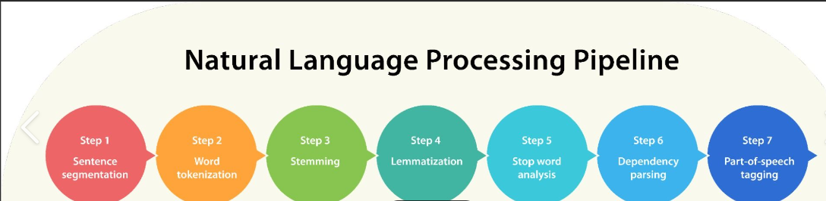
project statement
Objective: Develop a machine learning model to classify tweets as disaster-related or not disaster-related.
Problem Statement: During disasters, identifying relevant information from the vast number of tweets can be challenging and time-sensitive for emergency response teams

Slide 4
solution
I got solution from geeks for geeks and google .
Proposed Solution:
Leverage Natural Language Processing (NLP) to analyze tweet text.
Use a classification model to predict if a tweet indicates a disaster

Slide 5
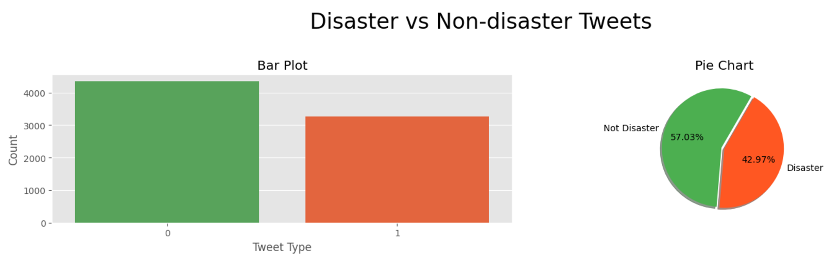
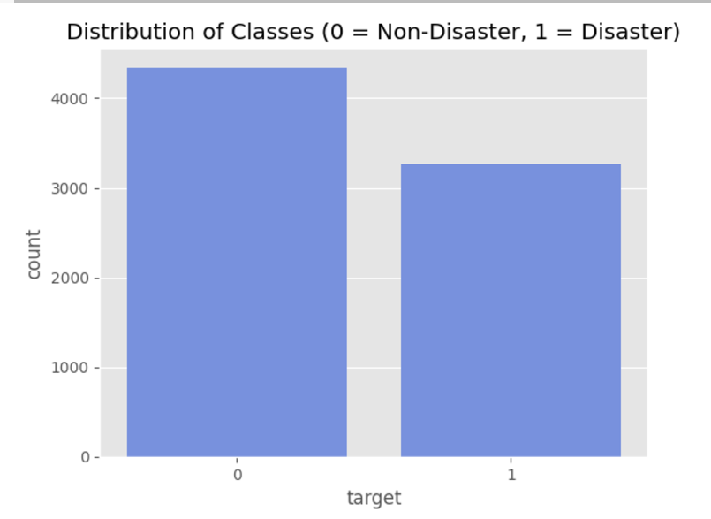
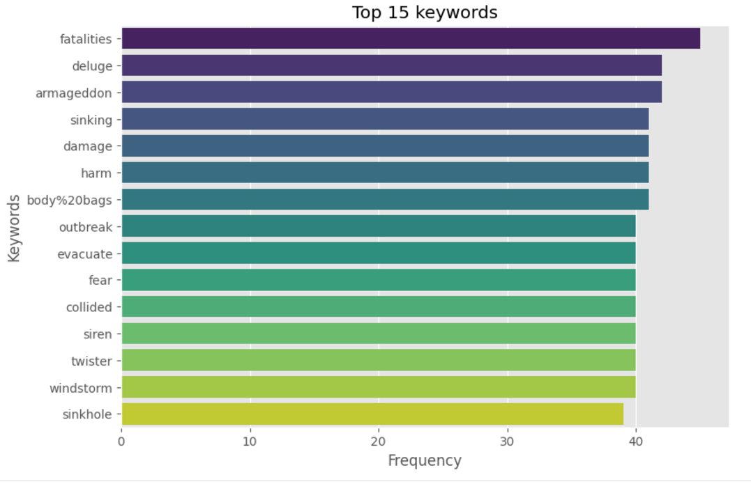
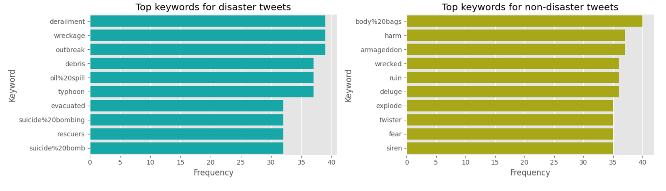
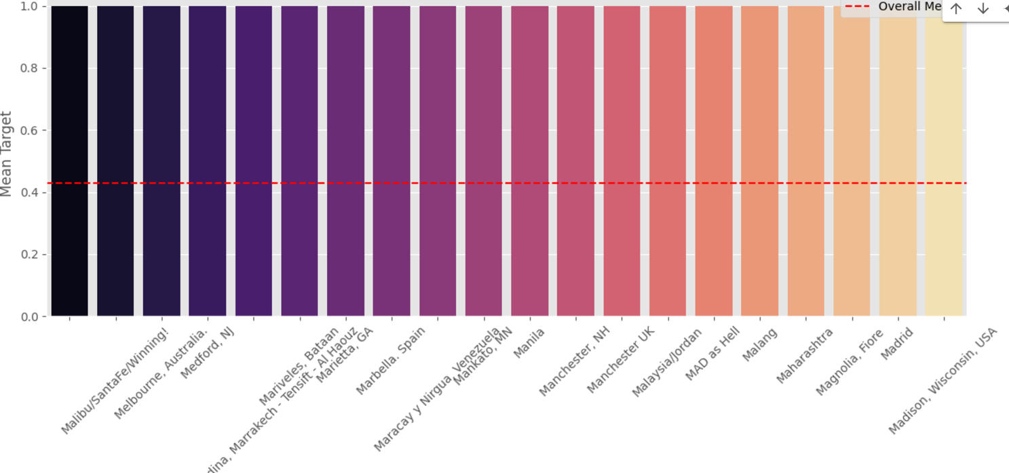
keyfeatures

Slide 6
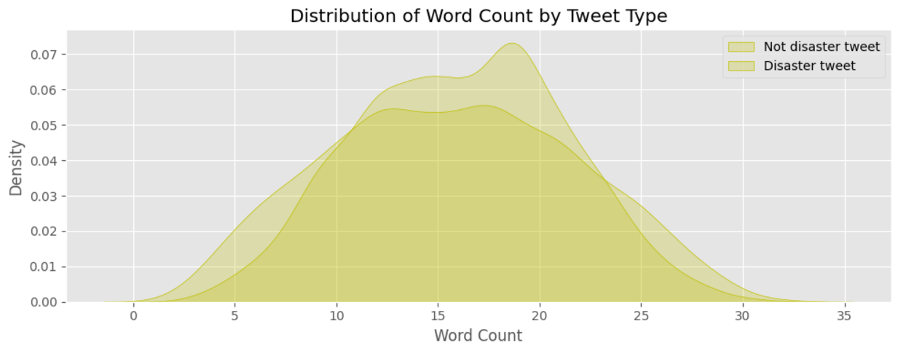
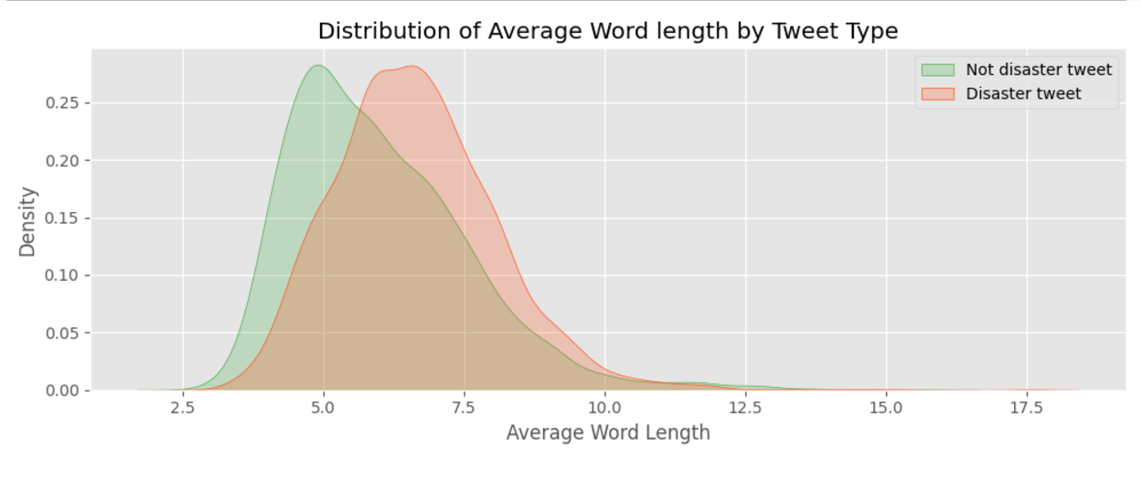
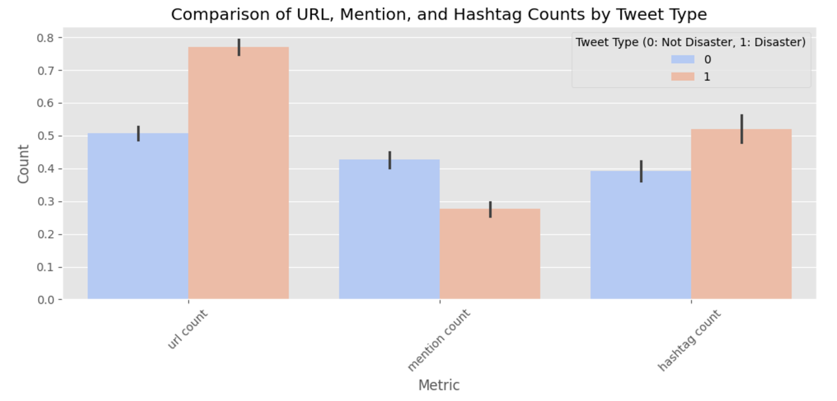
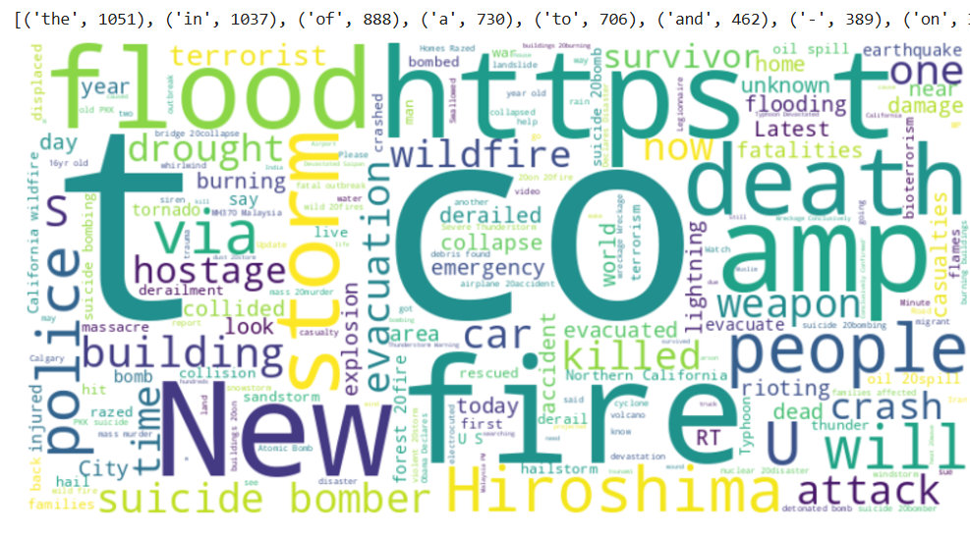
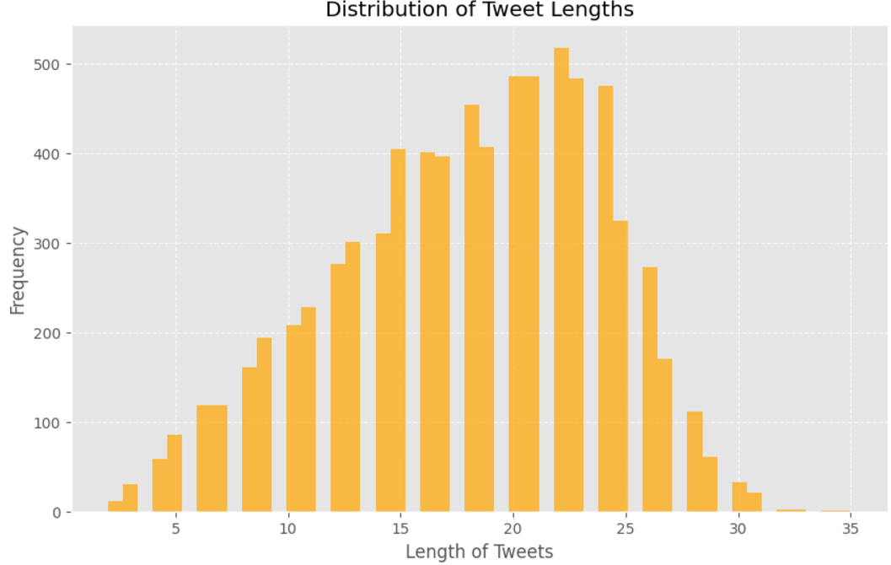
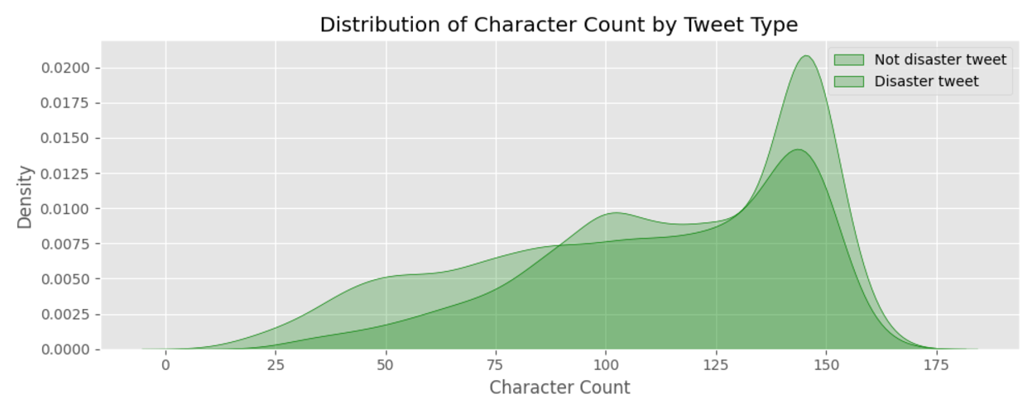
keyfeatures

Slide 7
methodology
Data Collection.Data Preprocessing. Feature Engineering.
Sentiment Analysis.Word Embeddings.Data Splitting.
Model Development. Model Evaluation. Deployment.

Slide 8
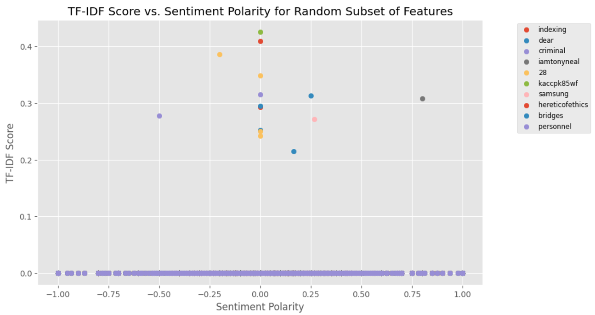
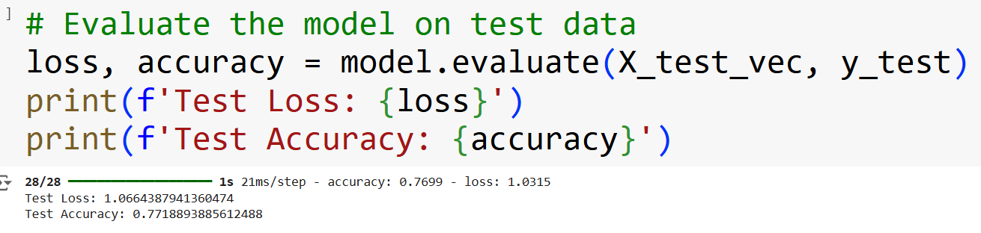
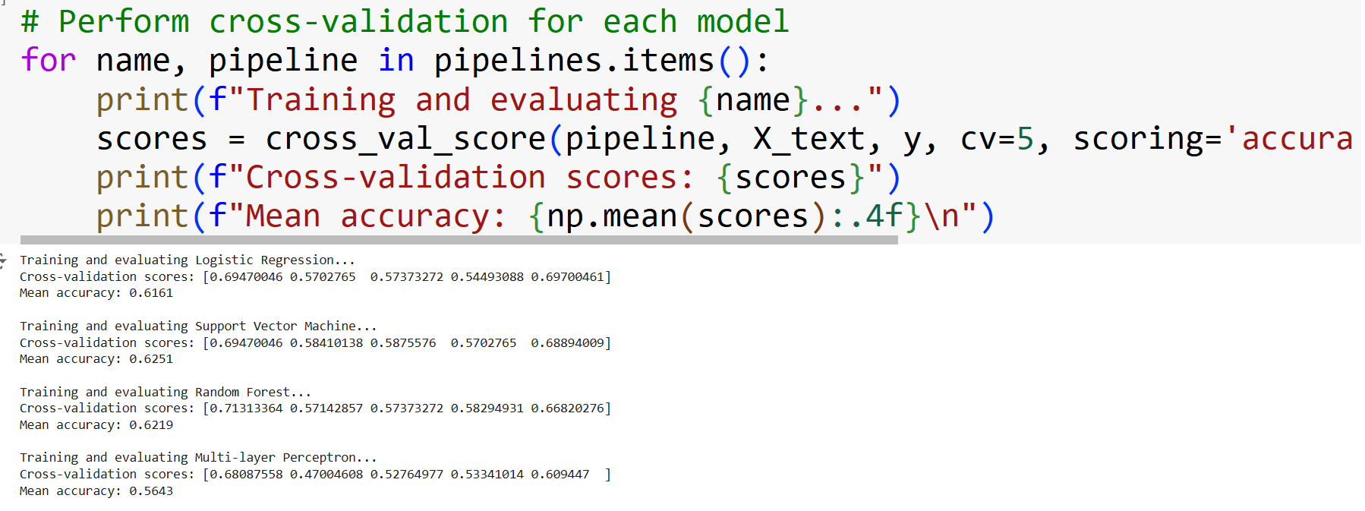
Result and achievments

Slide 9
challenges faced
I face the challenges in Deployment part

Slide 10
conclusion
we can enhance the ability to detect and respond to emergencies more
efficiently. This project represents a valuable opportunity to leverage NLP techniques for
the greater good, contributing to the advancement of disaster management and public
safety efforts.

Slide 11


